Slide 1
NETFLIX CONTENT ANALYSIS & CLUSTERING
Unsupervised Machine Learning Project
CHANDRU M D
25-02-2026

Slide 2
Project Objective
Analyze Netflix content trends and distribution
Identify growth patterns across years and countries
Segment similar content using clustering
Derive business insights for recommendation & strategy
Large and diverse content catalog
Difficult to extract structured insights
Need data-driven content strategy

Slide 3
Business Objectives
Analyze content growth over time
Compare Movies vs TV shows
Identify top genres
Study country contribution
Segment content using clustering

Slide 4
Dataset Overview
7,787 nTitles
12 features
Movies & TV shows
Key features: Genre, country, rating, Duration, Description

Slide 5
Data Cleaning & Preparation
Removed duplicates
Handled missing values
Converted date format
Extracted year & month
Processed duration

Slide 6
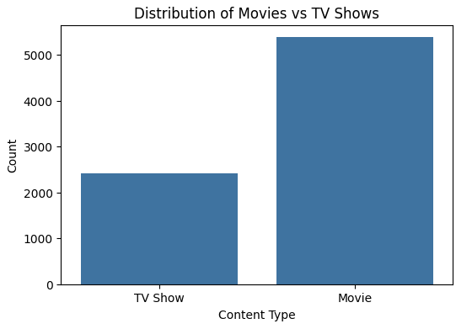
Movies vs TV Shows
Movies dominate overall
TV Shows growing

Slide 7
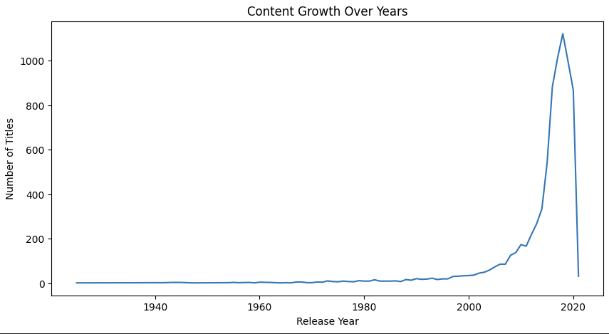
Year Added vs Content Type
Strong growth after 2015
TV Shows rising rapidly
Strategic shift observed

Slide 8
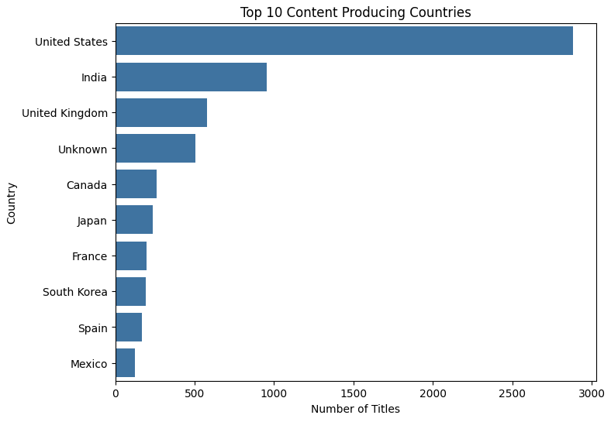
Top Countries
US dominates
India and UK strong contributors
Global expansion visible

Slide 9
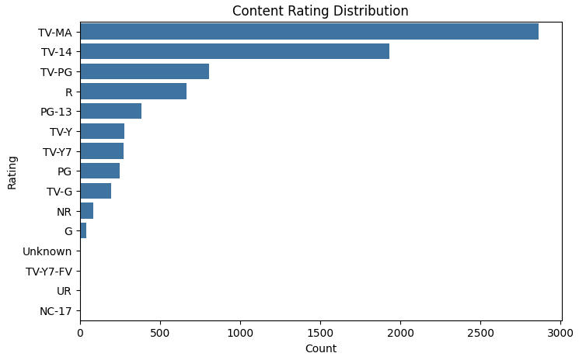
Duration Distribution
TV-MA & TV-12 dominate
Movies mostly 90-110 mins
TV Shows mostly 1-2 seasons

Slide 10
Clustering Process
Text Data
↓
Text Cleaning
↓
TF-IDF Vectorization
↓
KMeans & Hierarchical Clustering
↓
Content Segments

Slide 11
Cluster Insights
CLUSTER | THEME
0 | CRIME & THRILLER
1 | KIDS & FAMILY
2 | INTERNATIONAL DRAMA
3 | ACTION & ADVENTURE
4 | COMEDY
5 | DOCUMENTARIES

Slide 12
Business Recommendations
Increase high-performning TV Content
Expand regional production
Use cluster – based personalization
Maintain genre balance
Optimize release timing

Slide 13
Conclusion
Clear growth trends identified
Strategic shift towards TV Shows
Strong international expansion
ML-Powered segmentation

